Slide 1


AC-GAN
Andrea Arciprete & Daniela Chiavetta

Slide 2
Several studies have shown that GANs work very well and are able to generate high quality images when datasets consist of images characterized by low variability and low resolution. However, GANs are unable to generate images with high resolution when within the dataset there are images characterized by high variability. In this project, it has been shown that by slightly modifying the structure of a GAN, it is possible to generate images with higher resolution.

Slide 3
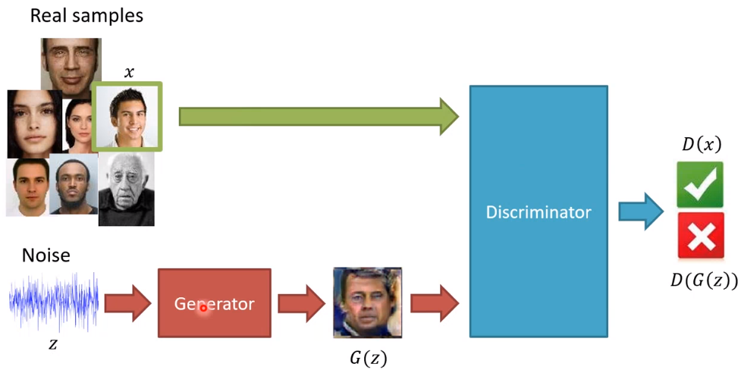
Before going into AC-GAN, let’s briefly resume the Generative Adversarial Networks and the Conditional Generative Adversarial Networks.
GAN
Generative Adversarial Networks, or GANs, are an architecture that allows us to apply the so-called Image Generation.
The architecture is composed of both a generator model that takes random points from a latent space as input and generates images, and a discriminator for classifying images as either real (from the dataset) or fake (generate).

Slide 4
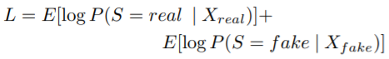
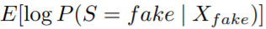
The discriminator is trained in order to maximize the log-likelihood of the discriminator. The discriminator’s log-likelihood makes us understand how good the discriminator is at classifying images that are actually fake as fake and images that are actually real as real.
The generator is trained in order to minimize the log-likelihood of the generator. The generator’s log-likelihood makes us understand how good the generator is at generating images as real as possible.

Slide 5
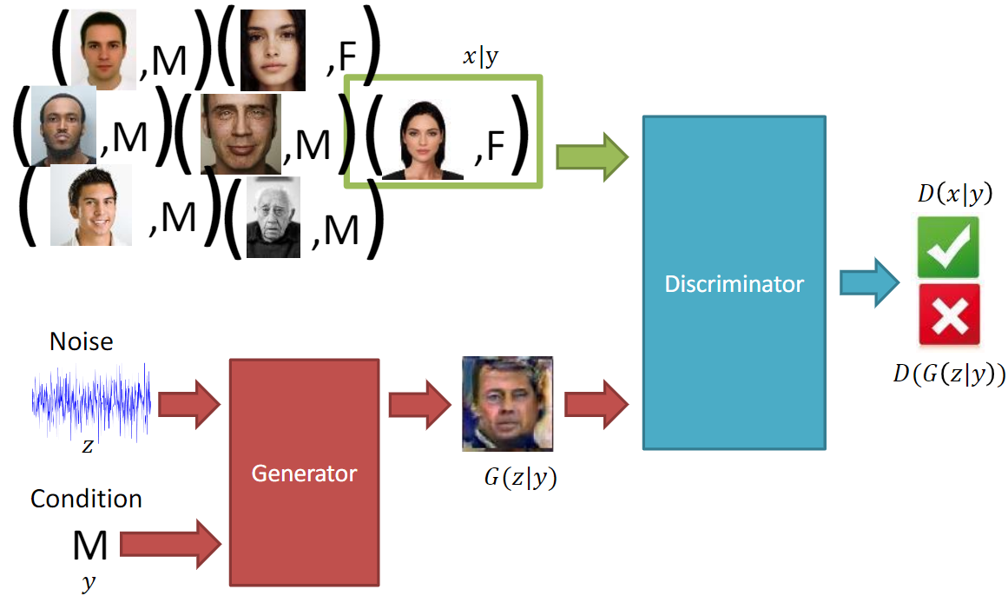
CGAN
A variant of traditional GAN is called CGAN.
The main difference between a GAN and a CGAN is the following: in a GAN, the generator learns how to generate images having a distribution that is acquired automatically by the generator. In a CGAN, the generator learns how to generate images with a distribution that is established by us. In other words, through the use of a CGAN, we can guide the generator to generate images belonging to classes we have decided.

Slide 6

Another variant that has been studied in depth within our project and which allows us to generate images with an even higher resolution is called AC-GAN.
AC-GAN
An AC-GAN is an extension of the CGAN as it provides the same generator as a CGAN but a slightly different discriminator. While the discriminator of a CGAN receives both the image coming from the generator or dataset and the target (real class of the image) and produces the probability that the input image is real and has the correct target, the discriminator of an AC-GAN receives in input only the image coming from the generator or dataset and produces the probability that the input image is real and the probabilities with which the input image belongs to each of the classes. To summarize, in an AC-GAN, the discriminator has to predict the target (real class) of the input image and if the input image is real or fake.

Slide 7
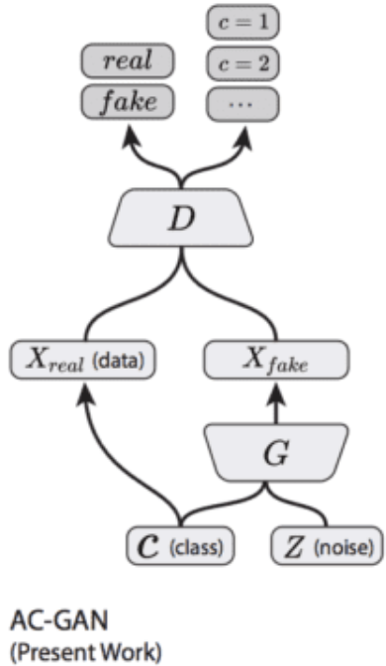

Slide 8
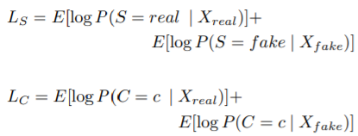
AC-GAN TRAINING
As we have said before, an AC-GAN is made up of two neural networks: a generator and a discriminator. For this reason, we have to train the generator and the discriminator at the same time.
The discriminator is trained to maximize the log-likelihood of the discriminator which gives us an idea of the ability of the discriminator to be able to correctly distinguish between a fake image and a real image and to be able to correctly predict real class of each input image.
The amount that must be maximized during discriminator training is Ls + Lc.

Slide 9
AC-GAN TRAINING
The amount that must be maximized during generator training is Ls - Lc.
The generator is trained to maximize the log-likelihood of the generator which gives us an idea of the generator’s ability to be able to generate images as real as possible.

Slide 10

How does the generator manage to generate a fake image?

Slide 11

As we have said, the generator receives a vector containing random noise and the target (real class of the image that the generator will generate). The generator gradually learns how to associate points that are inside the latent space with the points that are inside the image space. In practice, the generator gradually learns that a certain area of the latent space corresponds to a certain type of image and so on.

Slide 12
Advantage of AC-GAN
Disadvantage of AC-GAN
If we consider the C-GAN, we can say that we are forced to give the couple (image, target) to the discriminator of a C-GAN. While, by using the AC-GAN, it is possible to involve the semi-supervised learning. This because, instead of giving the couple (image, target) to the discriminator, it is also possible to give just the image since the corresponding class which the image belongs to, will be predicted by the auxiliary classifier of the discriminator. This makes AC-GAN more advantageous than a traditional classifier.
It has been demonstrated that AC-GAN, during the training phase, is able to generate high quality images only if the number of classes which images of the dataset can belong to, is low.

Slide 13
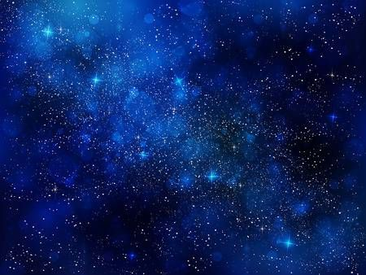
RESULTS FROM THE PAPER
The authors have demonstrated that, by increasing the number of classes which images can belong to, the output (images generated by the generator) quality gets lower. Fortunately, AC-GAN 's structure allows us to split datasets into subsets and also to train both generator and discriminator using these subsets.
For this reason, the authors trained AC-GAN by using ImageNet as dataset, but they did not use the whole dataset. In fact, they used 100 AC-GANs, each of them trained using a portion of the ImageNet dataset, so that images could only belong to 10 classes.

Slide 14
RESULTS FROM THE PAPER
The first important result that has been obtained is that by using AC-GAN it is possible to generate high resolution images. The generation of high-resolution images increases the discriminability.
Just to clarify, the fact that the generation of high-resolution images increases the discriminability is valid only if we use an AC-GAN.

Slide 15
RESULTS FROM THE PAPER
In order to generate high resolution images, rather than using AC-GAN, it is also possible to use the so-called bilinear interpolation, but if we use this strategy the only goal we can achieve is the generation of high resolution images because by using the bilinear interpolation it is not possible to increase the discriminability. For this reason, if we only want to generate high resolution images, we can use the bilinear interpolation but if we also want to increase the discriminability, we must necessarily use the AC-GAN.
To prove this, the authors of the article demonstrated that reducing the image resolution more and more also reduces the ability to correctly predict the class to which the input image belongs to.

Slide 16
DEMONSTRATION USING INCEPTION ACCURACY
To do this, they used the generator of an AC-GAN in order to generate several images with a resolution of 256 x 256. Then, they applied different bilinear interpolations to each single image generated by the generator and to each image coming from the dataset in order to reduce its resolution. In particular, from each image of size 256x256 they obtained the same image having a resolution of 128x128, the same image having a resolution of 64x64 and so on.

Slide 17
DEMONSTRATION USING INCEPTION ACCURACY
After that, each of these images (coming from the generator or the dataset) was sent in input to an Inception network, already pre-trained using ImageNet dataset.
Then, the Inception output (the prediction related to the class to which each of these images belongs to) was taken and finally the Inception Accuracy was calculated.

Slide 18
DEMONSTRATION USING INCEPTION ACCURACY
The authors have seen that images (real or fake) with a lower resolution imply lower Inception Accuracy and a reduced ability to correctly predict the real class to which each image belongs to, in other words: a smaller discriminability.

Slide 19
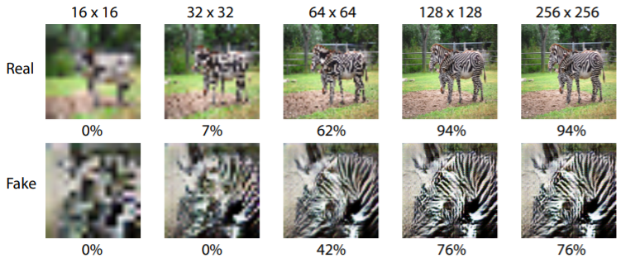

Slide 20

COLLAPSE OF THE GENERATOR

Slide 21
The generator collapses as soon as it is no longer able to generate a variety of different images belonging to the same class but starts to generate always the same images. This is a big problem! If the generator starts to generate the same images, the discriminator very quickly learns how to distinguish between fake images and real images and the model training is stopped very quickly.
It is useful to evaluate the ability of the generator to generate a variety of different images belonging to the same class. To do this, the authors of the article used a metric called multi-scale structural similarity (MS-SSIM).

Slide 22
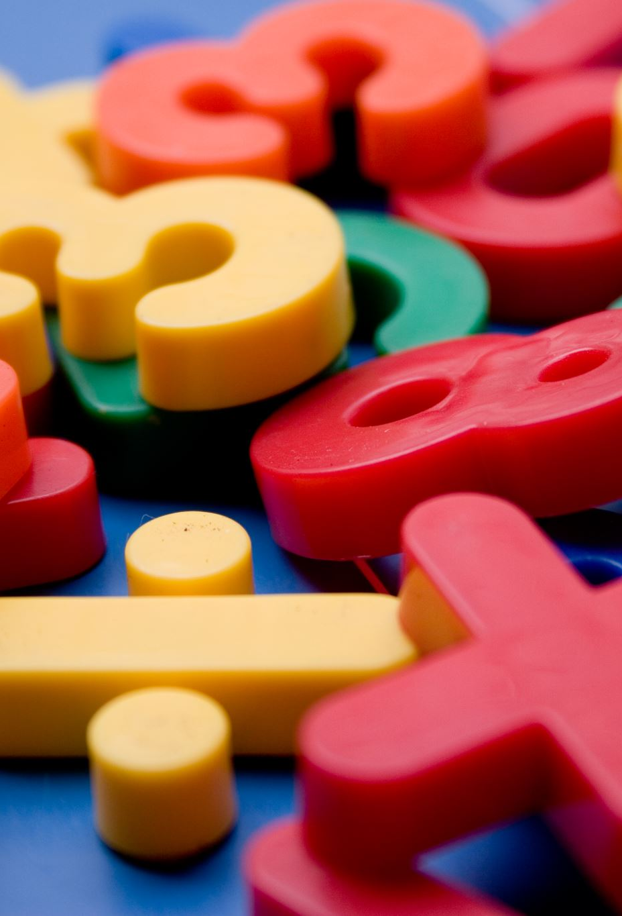
MS-SSIM
The MS-SSIM is calculated for a certain number of images belonging to the same class and can assume a value between 0 and 1.
More the value of the MS-SSIM is closer to 1, more the images belonging to the same class that are taken into consideration for this calculation are similar to each other.
Because our goal is to make the generator generate a variety of different images belonging to the same class, it is better a MS-SSIM value closer to 0.

Slide 23
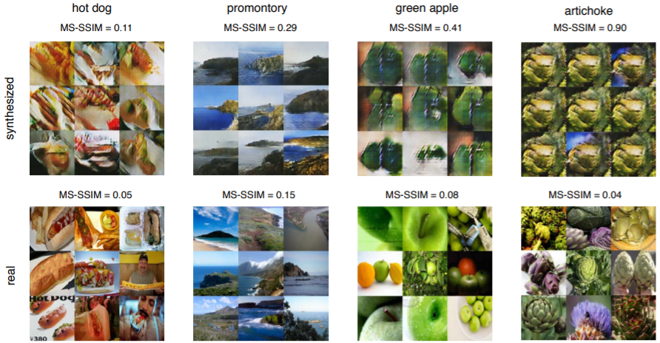

Slide 24
AC-GAN ARCHITECTURES AND OUR RESULTS

Slide 25
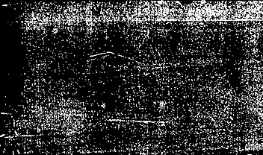
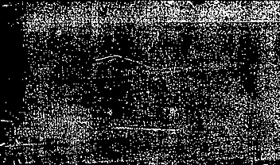
AC-GAN MNIST-1

Slide 26
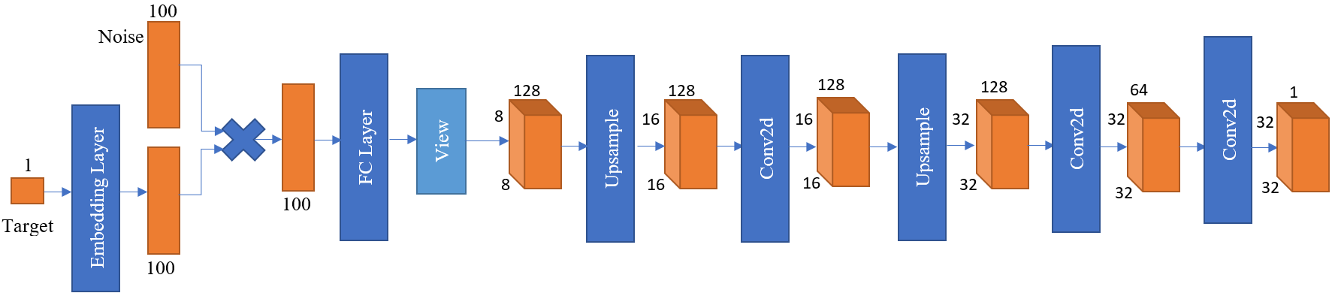
GENERATOR

Slide 27
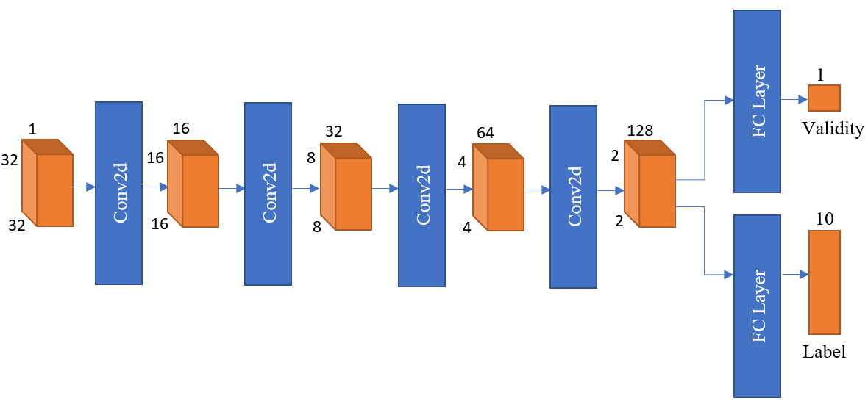
DISCRIMINATOR

Slide 28
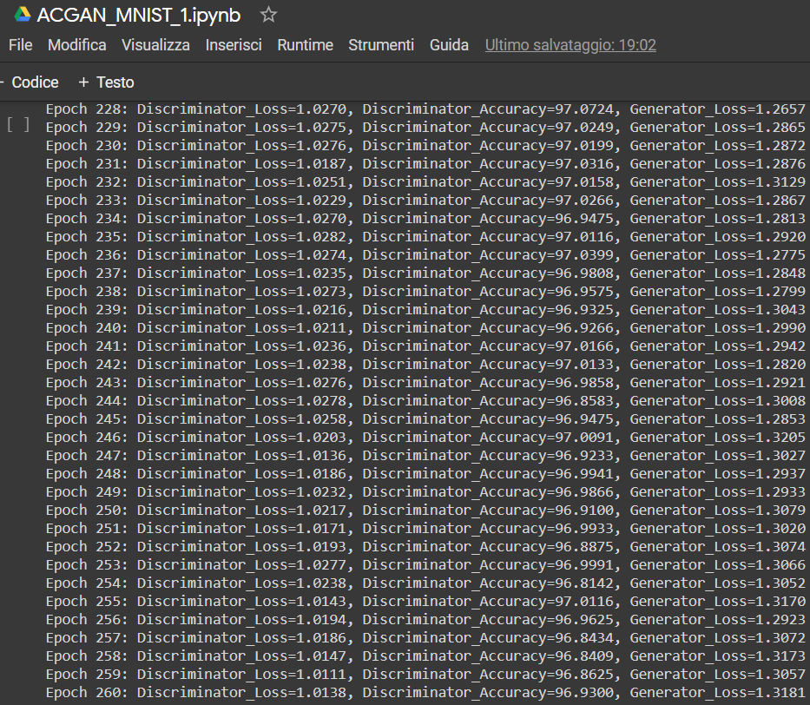
ACGAN-MNIST-1

Slide 29
AC-GAN MNIST-2

Slide 30
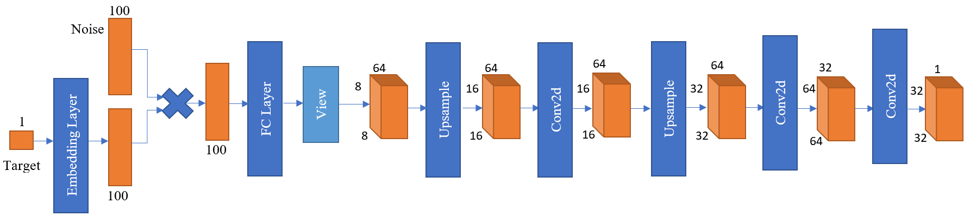
GENERATOR

Slide 31
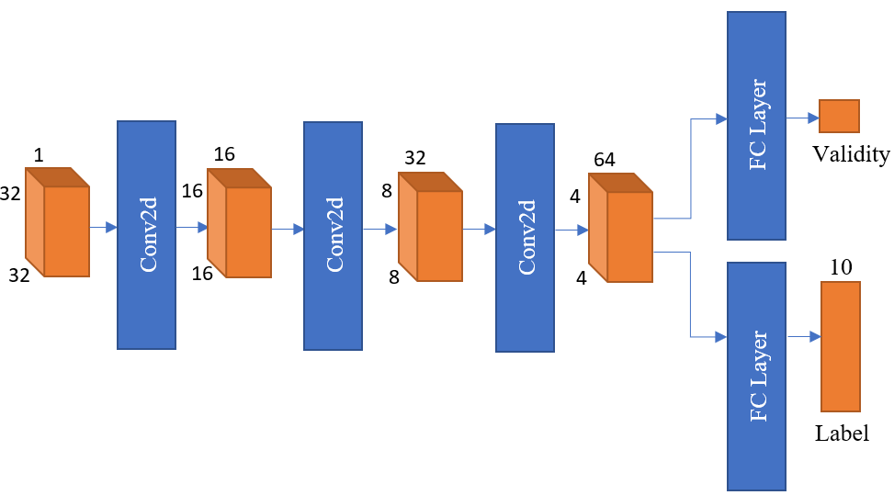
DISCRIMINATOR

Slide 32
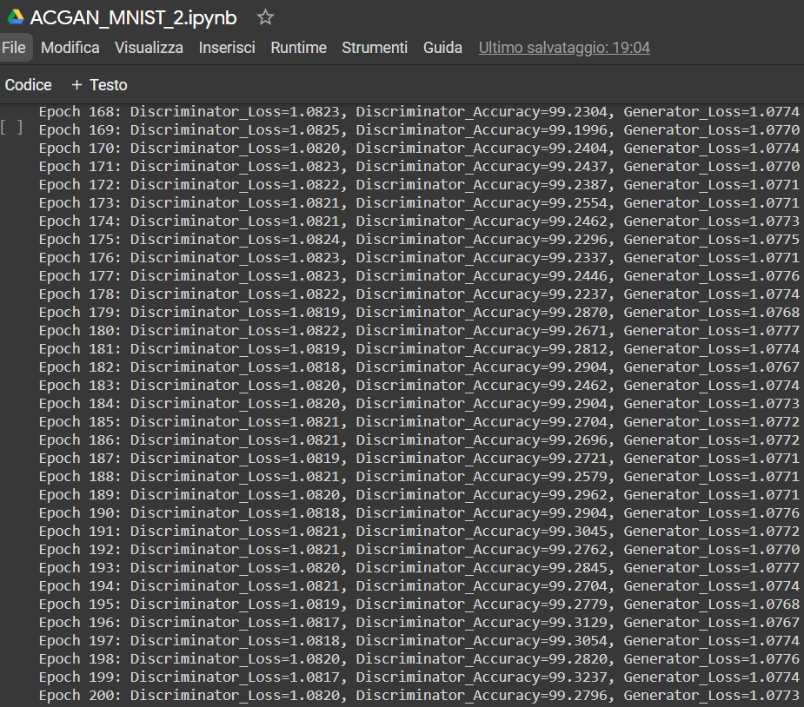
ACGAN-MNIST-2

Slide 33
AC-GAN CIFAR10-1

Slide 34
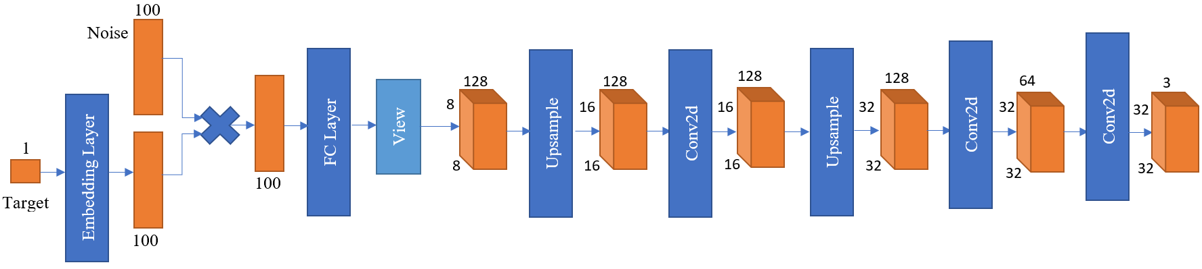
GENERATOR

Slide 35
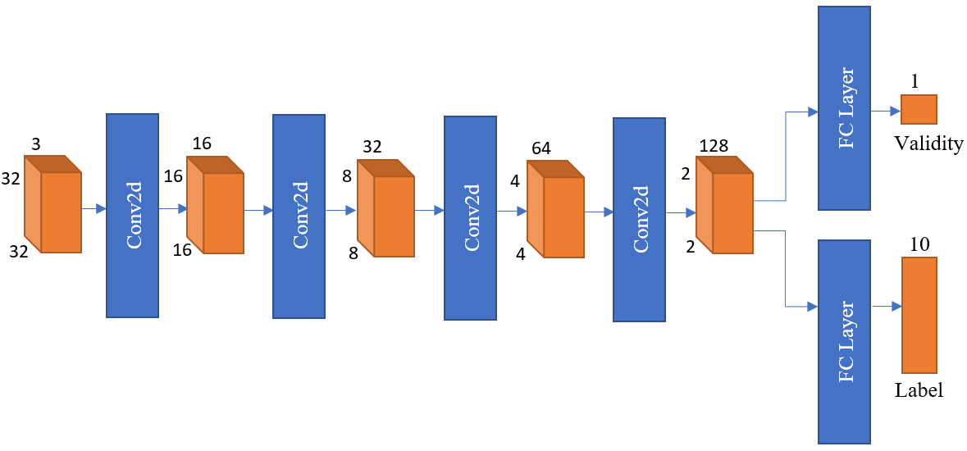
DISCRIMINATOR

Slide 36
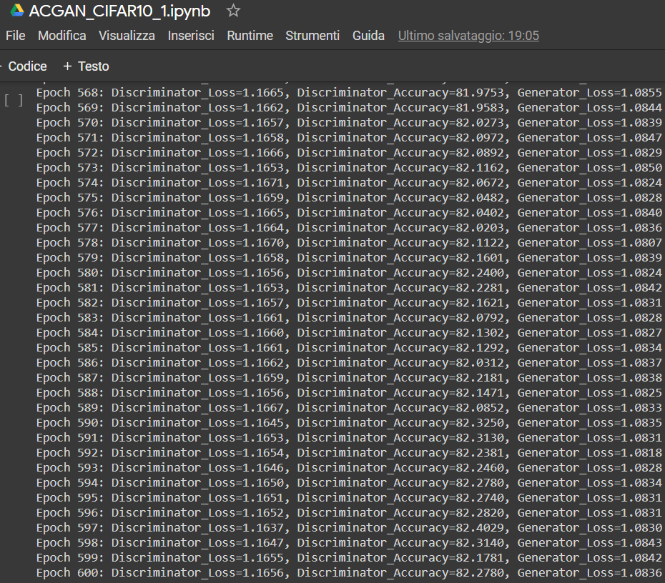
ACGAN-CIFAR10-1

Slide 37
AC-GAN CIFAR10-2

Slide 38
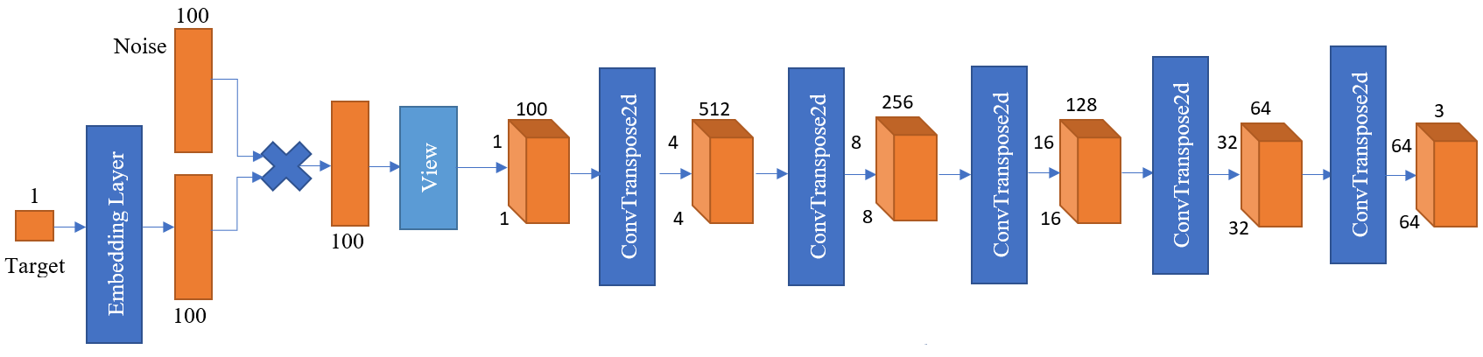
GENERATOR

Slide 39
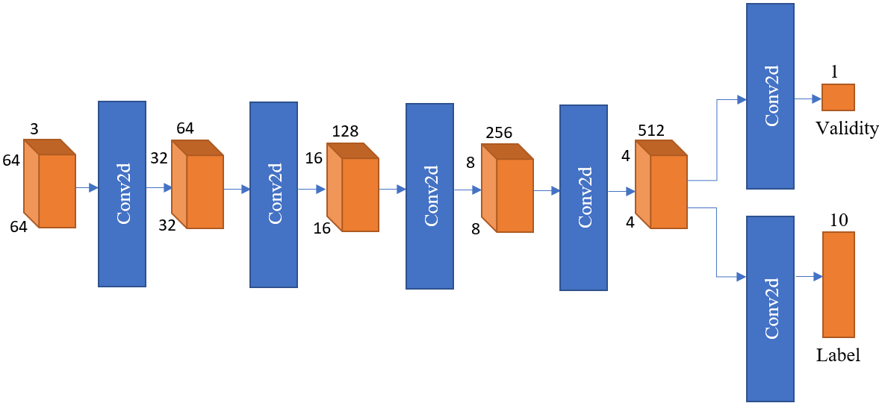
DISCRIMINATOR

Slide 40
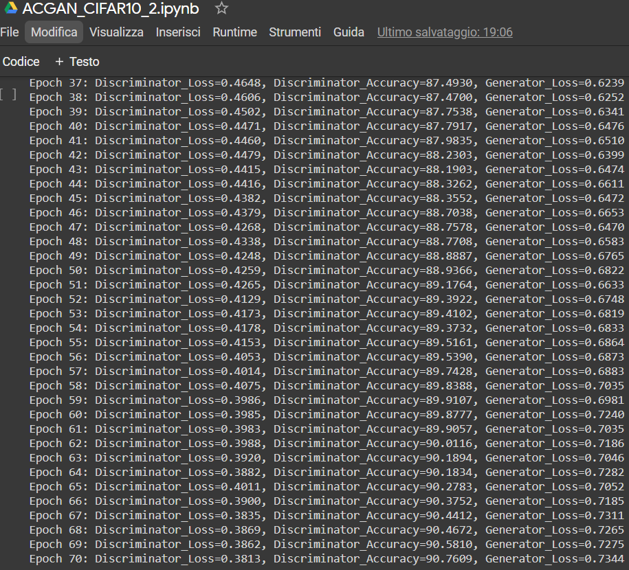
ACGAN-CIFAR10-2

Slide 41
CONCLUSIONS
Thanks to this project, we have understood that by using AC-GANs it is possible to stabilize the training process and generate high resolution images in order to increase the discriminability.
Furthermore, we have learnt that by using the concept of Inception Accuracy, it is possible to evaluate the performance of an AC-GAN.
We have also learnt the existence of a metric called multi-scale structural similarity (MS-SSIM), that can be used to measure the ability of the AC-GAN generator to generate a variety of different images belonging to the same class.
Finally, we can say that thanks to this project we have learnt how it is possible to implement and train an AC-GAN using Pytorch.

Slide 42


